Slide 1

Inox Cinema World
Home
Bollywood
Hollywood
Image gallery
Booking
Sign in
Flash Player (with Current movie Video)
Movie1
Movie2
Movie3
Movie4
Movie5
Moive6

Slide 2
Inox Cinema World
Home
Bollywood
Hollywood
Image gallery
Booking
Sign in
Current Bollywood Movie slide show
Movie1
Movie2
Movie3
Movie4
Movie5
Moive6

Slide 3
Inox Cinema World
Home
Bollywood
Hollywood
Image gallery
Booking
Sign in
Current Hollywood Movie slide show
Movie1
Movie2
Movie3
Movie4
Movie5
Moive6

Slide 4
Inox Cinema World
Home
Bollywood
Hollywood
Image gallery
Booking
Sign in
Image Gallery slide show
Bollywood Movie Images
Bollywood Movie Images
Image1
image
image3
image4
Image1
image
image3
image4
image5
image6
image7
image8
image5
image6
image7
image8

Slide 5
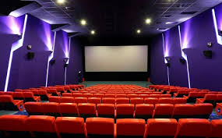
Inox Cinema World
Home
Bollywood
Hollywood
Image gallery
Booking
Sign in

Slide 6
Inox Cinema World
Home
Bollywood
Hollywood
Image gallery
Booking
Sign in
User Name
Password
Terms and condition and copy right information

Slide 7
Inox Cinema World
Home
Bollywood
Hollywood
Image gallery
Booking
Sign in
First Name:
Last Name:
E-mail:
Contact No:
Subject:
Comments:

